Slide 1
Linear Models (cont.)

Slide 2
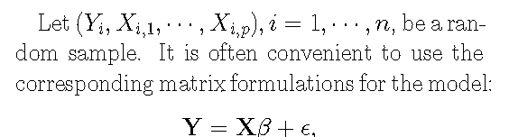

Slide 3
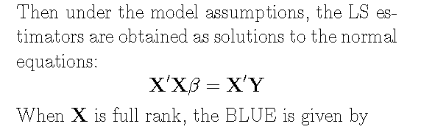

OLS estimators, BLUE in the class of linear unbiased estimators.

Slide 4
Topics
Model Validation
Linearity
Independence
Normality
Homoscedasticity
Influential Points
Robust Regression
Multicollinearity
Ridge Regression
Principal Components
Model Selection
LASSO

Slide 5
Multicollinearity
Presence of a high degree of correlation among several independent variables.
Effects?

Slide 6
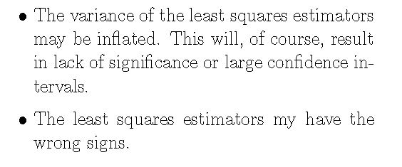
Multicollinearity: Effects

Slide 7
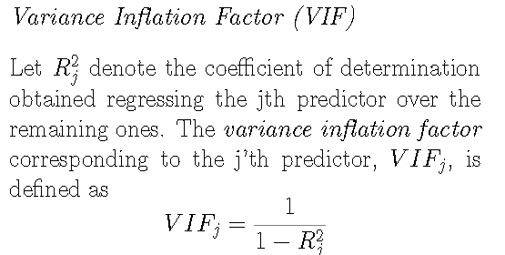
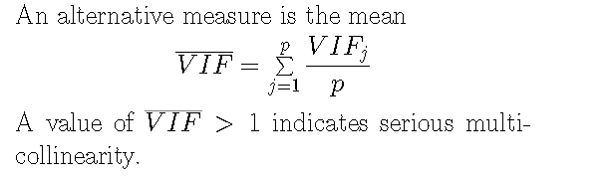
Detection of Multicollinearity
Rule of thumb: VIF > 10 , multicollinearity

Slide 8
Detection of Multicollinearity (cont’d)
Condition Number
Let R_{xx} denote the correlation matrix of X.
Condition number:
Ratio of largest to smallest eigenvalues of R_{xx}
When exact collinearity, all eigenvalues will be 0.
A condition number > 30, multicollinearity
Values > 1000 generally imply serious collinearity.

Slide 9

Ridge Regression
Goal: Obtain estimators with some bias, but with smaller variance than an unbiased estimator.
A combined measure of bias and variance:
Find an estimator which minimizes the MSE.

Slide 10
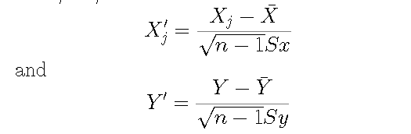
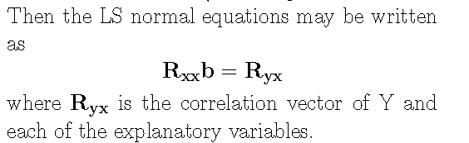
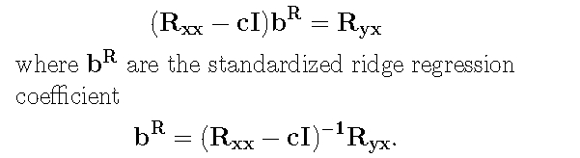
Define the correlation transformations:

Slide 11
Principal Component Regression
A common technique of obtaining uncorrelated predictors
Involves transforming the independent variables using eigenvectors of R_{xx}.
New variables, called principal components, are linear combinations of the original X's.
Idea: Regress Y on the k useful principal components.
Major drawback: Interpretation of the results not straightforward.

Slide 12
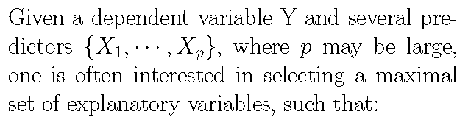
Model Selection
The selected variables provide maximal predictive value
All redundant variables are excluded from the model
The size of the included set of variables permits the estimation of parameters with reasonable precision.

Slide 13
Why a parsimonious model?
When number of variables is large relative to the number of observation, estimates of associated variables may be unstable or imprecise.
Interpretation of models with too many predictors may be complex
Too may variables may involve cumbersome computational efforts.

Slide 14
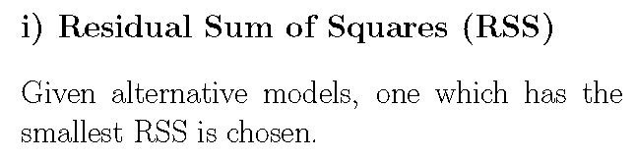

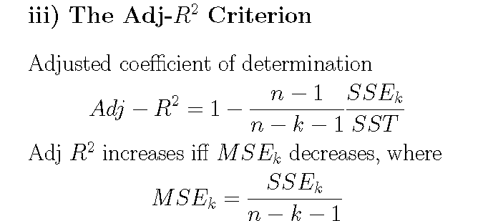
Criteria for Model Selection

Slide 15
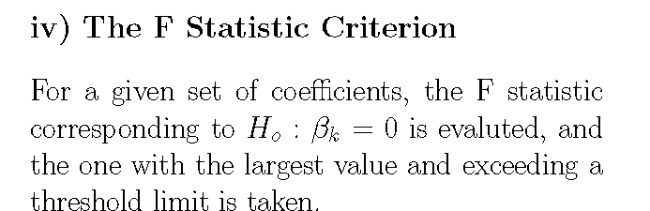
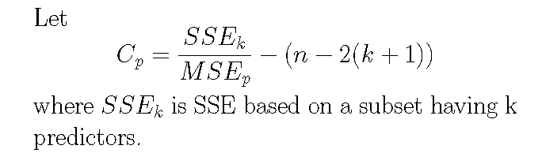
Criteria for Model Selection

Slide 16
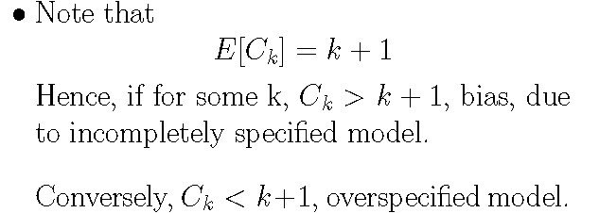
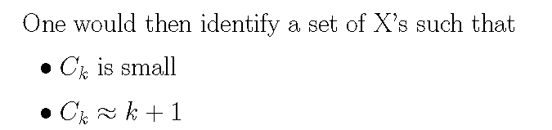

Criteria for Model Selection (cont’d)

Slide 17
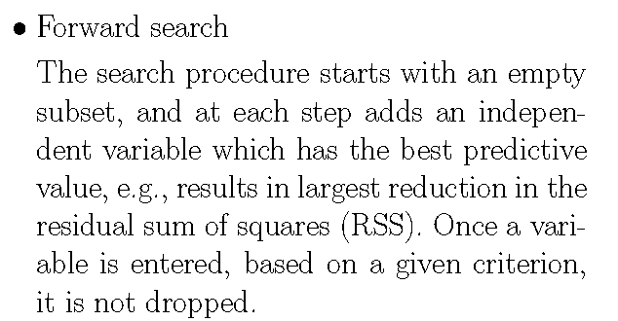
Stepwise Regression
Backward elimination
Begin with a model containing all potential explanatory variables.
At each step drop explanatory variable with least predictive value.
Approach is computationally more cumbersome than forward method.

Slide 18
Stepwise Regression (cont’d)
Efroymson's method
Similar to forward search approach, except that when a new variable is entered, partial correlations are considered to see if any of the variables in the model should now be dropped.
Exhaustive search
Searches the optimal model by looking at all possible subsets and then looking at the criteria corresponding to the best subset.
When p is large, this approach may not be appropriate

Slide 19

R functions:
> library(help="MASS")
> help(stepAIC)

Slide 20
Statistical Issues with Stepwise Model Selection Procedures
Stepwise regression should only be used for exploratory purposes or for purposes of pure prediction
It should not be used for theory testing
Hypothesis must be pre-specified
Nominal significance level used at each step is subject to inflation
Hard to adjust for multiplicity
Automated fitting may lead to over-fitting
Generalization across data unreliable
R² estimates too high
Confidence intervals too narrow
Affected by multicollinearity
Dummy variables are usually treated individually
No obvious approach to add/remove sets of dummy variables
Reading Assignment
See references given in: http://www.stata.com/support/faqs/stat/stepwise.html

Slide 21

Least Absolute Shrinkage and Selection Operator LASSO
Minimize
Penalizing the absolute values of the coefficients causes shrinkage towards zero
Unlike ridge regression, some of the coefficients are shrunken all the way to zero (i.e., dubbed sparse)
Hence, performs variable selection
No closed form expression for estimators, unlike ridge
Can handle large p > n.
Optimization algorithms:
LARS (Least Angle Regression) https://web.stanford.edu/~hastie/Papers/LARS/LeastAngle_2002.pdf
Coordinate descent

Slide 22
Ridge Reg, LASSO, Elastic Net
Reading assignment: Differences and similarities among Ridge Regression, lasso and Elastic Net.
http://statweb.stanford.edu/~tibs/ElemStatLearn/printings/ESLII_print10.pdf
In R, the glmnet package
Fits: linear models, generalized linear models, multinomial models, proportional hazards models
fit <- glmnet(X,y)
cvfit <- cv.glmnet(X,y)
plot(cvfit)
SAS
PROC GLMSELECT DATA=dataset PLOTS=ALL;
MODEL y = x1 x2 ,,,, / SELECTION=LASSO(STOP=NONE) STATS=SBC;
RUN;
Selection criteria, include cross-validation
GLMSELECT fits only linear models, not GLMs

Slide 23

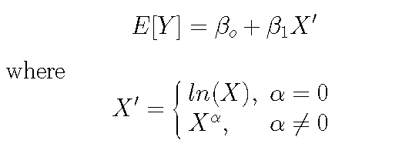
Transformations
Transforming models to achieve linearity
Box-Tidwell transformations

Slide 24



Transformations (cont’d)
Box-Cox transformation
In R, boxcox(); library(MASS)

Slide 25
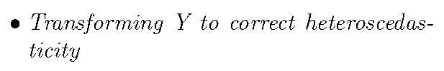
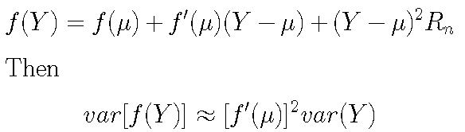
Transformations (cont’d)
If Y is binomial, may use arcsin transformation.
For Poisson: Sqrt

Slide 26

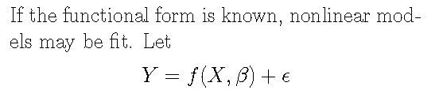
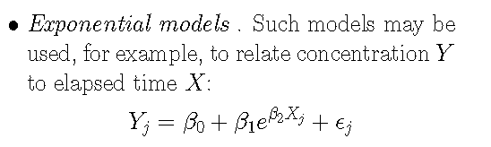
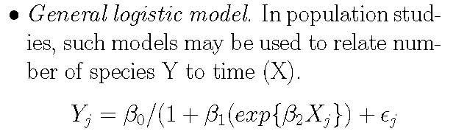

Slide 27
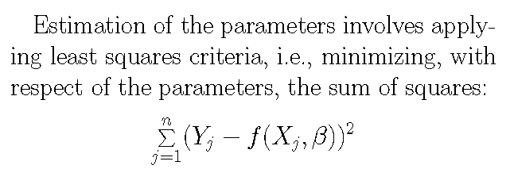



Solutions are often obtained by numerical methods.
Reading Assignment

Slide 28
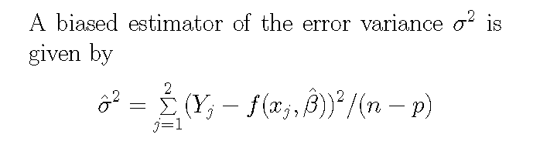
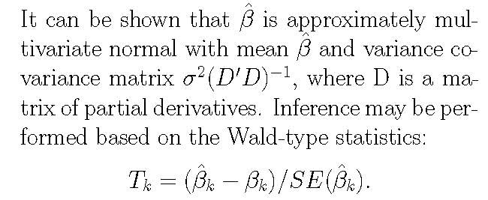

Slide 29
Example 1. Orange[1:4,]
Grouped Data: circumference ~ age | Tree
Tree age circumference
1 1 118 30
2 1 484 58
3 1 664 87
1 1004 115
…..
R
nlsfit _ nls(circumference~A/(1+exp(-1*(age-B)/C)),
data=Orange, start=list(A=150,B=600,C=400))
> summary(nlsfit)
Parameters:
Value Std. Error t value
A 192.718 20.2602 9.51214
B 728.912 107.3770 6.78836
C 353.650 81.5052 4.33898
Residual standard error: 23.3721 on 32 degrees of freedom

Slide 30

Scatterplot Smoothers
Let Y=f(x) +e, with functional form of f unknown
Given data: (x₁,y₁), ….., (x_{n},y_{n}), approximate f(x), by
Example 2: Suppose f(x) = sin(2 * pi * (1 - x)^2)
x <- runif(200)
e <- rnorm(200)
x <- sort(x)
fx <- sin(2 * pi * (1 - x)^2)
y <- fx + x * e
Generate
200 data points

Slide 31
f(x)=sin(2 * pi * (1 - x)^2)

Slide 32


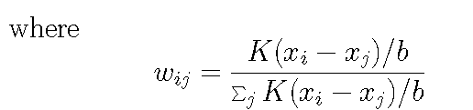
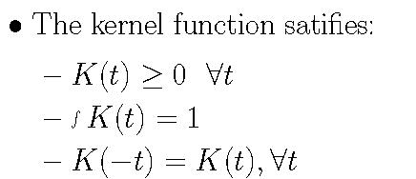
Scatterplot Smoothers
Approximate f(x) by :

Slide 33
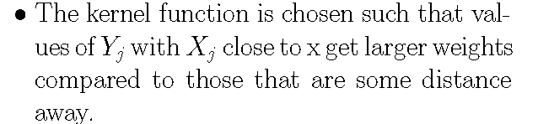
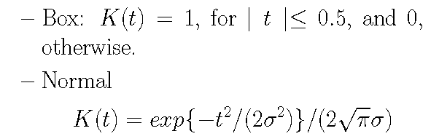
Common choices:

Slide 34
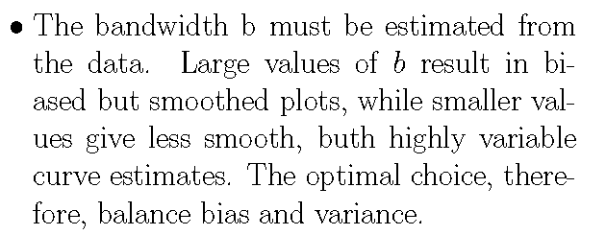
R functions
library(KernSmooth)

Slide 36

WLS fit of y are computed based on the k nearest neighbors of x.
Typically, a fixed span, i.e., the fraction of nearest neighbors, is kept constant for the entire range of x.
The choice of the span is again determined with a view to balancing between variance and bias.

Slide 38
Supersmoother
Employs variable bandwidth (span), which is selected based on the data.
Cross-validation technique is employed for the optimal bandwidth corresponding to each data point.

Slide 40
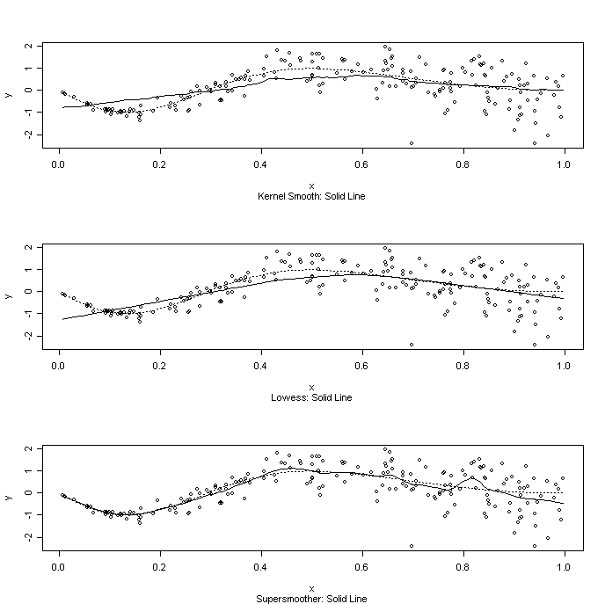
R Function
Smoother <-function()
{
set.seed(15)
x <- runif(200)
e <- rnorm(200)
x <- sort(x)
fx <- sin(2 * pi * (1 - x)^2)
y <- fx + x * e
par(mfrow = c(3, 1))
plot(x, y)
lines(x, fx, lty = 3)
lines(ksmooth(x, y))
title(sub = "Kernel Smooth: Solid Line")
plot(x, y)
lines(x, fx, lty = 3)
lines(lowess(x, y))
title(sub = "Lowess: Solid Line")
plot(x, y)
lines(x, fx, lty = 3)
lines(supsmu(x, y))
title(sub = "Supersmoother: Solid Line")
}

Slide 41
Problem Set 4
Reading Assignment: Ramsey & Schafer, Chapters 9, 10, 11, 12.
Consider the data set birthwt in R library MASS.
1. Consider a multiple linear regression model of 'bwt' birth weight in grams on the explanatory variables:
'age' mother's age in years
'lwt' mother's weight in pounds at last menstrual period
'race' mother's race (‘0' = white, ‘1' = other)
'smoke' smoking status during pregnancy
'ptl' number of previous premature labours
'ht' history of hypertension
'ui' presence of uterine irritability
'ftv' number of physician visits during the first trimester
Investigate whether there is any multicollinearity
Run a ridge regression analysis and compare the results with (i) above
Compare models selected using LASSO and a stepwise procedure to predict 'bwt' birth weight in grams using the above set of predictors.
For the procedures listed in Table 1 next page, give appropriate ranks with respect to the listed attributes: 1 = Good, 2 = Fair, 3= Poor. Given supporting reference from the literature, if you wish.

Slide 42
Table 1. Rating of performance of procedures:1 = Good, 2 = Fair, 3= Poor.
 | OLS | Ridge | lasso | Elastic Net
Performance when p >> n (high dimensional feature space)
Performance under multicollinearity
Unbiased estimators
Model selection capability
Simplicity: Computation, Inference, Interpretation

Slide 43
Presenters 10/7/2016
7:50-8:00 | Group 27
8:00 -8:10 | Group 14
8:10-8:20 | Group 11
Waitlist: Group 28
11 | Nian,Yiqun | An,Huilong | Lin, Zida | Zhang,Xiaohan | Hu, Yifei | Qin, Yu | Dai, Peijun | Gu, Kexin
14 | Jin, Zhaoyan | Ji, Chenlu | Wang, Jiayi | Lu, Ke | Zhang, Xuan | Zhang, Chi | Lang, Yifei | Yu, Tianying
27 | Zhao, Jingdan | Yao, Mi | Zhang, Sumi | Zhang, Jinglun | Sun, Haocheng | Che, Yilin | Wang, Yuanyuan
28 | Xu, Linyihui | Kun Fan | Shuzhe Wu | Xi Lu | An, Ji | Gao, Qihua | Fan, Zhenlan | Sheng,Ming | Zhang, Lu

Slide 44
 | Name: Last, First | Name: Last, First | Name: Last, First | Name: Last, First | Name: Last, First | Name: Last, First | Name: Last, First | Name: Last, First | Name: Last, First | Name: Last, First
1 | Wang, Yicheng | Xue, Yichao | He, Hanming | Zhang, Tian | Yi, Ziyun | Tao, Mengyuan | Tian, Jiani | Wang, Shiyu
2 | Li, Jingwei | Liu, Ao | Wu, Xiangyu | Yang, Yutong | Aoyuan, Liao | Yi, Jian | Zhang, Wanyi | Wang, Jia | Gao, Duanhong | Shi, Hanqing
3 | Bai, Silvia | Cai, Weipan | Dai, Di | Han, Siqi | Xie, Tianzhao | Yang, Mengting | Zeng, Cen | Zhuang, Shiyu | Zhang, Yifan | Huang, Rui
4 | Zuo,Nianyao | Chen,Jiayang | Huang,Xiangkai | Tang,Mingzhen | He,Jin | Li,Weihan | Gao,Fei | Qin,Liwen | Zuo,Zhaoyu
5 | Yang, Chuhan | Duan, Ziying | Chen, Jinglin | Huang, Yirui | Zhu, Ming | Liu, Zhaoze | Yin, Qing | Zhang, Baizheng | Yue, Wenshu | Zeng, Neng
6 | You, Guanzhong | Wang, Lu | Zhou, Xingyu | Luan, Sitao | Bao, Wenhang | Liu, Chang | Yang, Tianmeng | Zhu, Feiran | Chen, Jie
7 | Zhang, Yunyi | Qin, Yunlin | Liu, Haojiang | Fei, Yang | Kim, Hayoung | Cho, Younhyuk | Song, Hyoungmook | Fan, Yang | Wang, Weitong
8 | Jin, Chengzhe | Liu, Youzhu | Yu, Xingzao | Zhu, Ying | You, Jiwen | Li, Linna | Lyu, Yihua | Ye, Hexiu | Lin, Chi-Heng | Jiang, Bo
9 | Wang, Suling | Cheng, Tianyuan | Li, Cheng | Wang, Han | Shang, Renfei | Yao, Wei | Yu, Zhao
10 | Chen, Haoyang | lin | Zhou, Longwei | Chen, Zachary | Huang, Biyue | Qian, Quan
11 | Nian,Yiqun | An,Huilong | Lin, Zida | Zhang,Xiaohan | Hu, Yifei | Qin, Yu | Dai, Peijun | Gu, Kexin
12 | Gao, Chenying | Yao, Weichi
13 | Sun, Yuhan | Zhou, Jingying | Jiang, Chencheng | Teng, Yueying | Wang, Yanran | Gu, Xinghao | Chen, Ying | Meng, Ziwei
14 | Jin, Zhaoyan | Ji, Chenlu | Wang, Jiayi | Lu, Ke | Zhang, Xuan | Zhang, Chi | Lang, Yifei | Yu, Tianying
15 | Chen, Geer | Wang, Bo | Zhao, Edward | Zhang, Keren | Bao, Yu | Ren, Ruoxi | Zhang, Yunyi | Wang, Xiaoxiao | Zhou, Xiaoyu | Sun, Sirui

Slide 45
 | Name: Last, First | Name: Last, First | Name: Last, First | Name: Last, First | Name: Last, First | Name: Last, First | Name: Last, First | Name: Last, First | Name: Last, First | Name: Last, First
16 | Wang, Yiren | Li, Yanjin | Wen, Litong | Lu, Yicheng | Sun, Xuechun | Wang, Yue | Zhao, Fei
17 | Chen, Yihe | Lao, Palmer | Li, Daitong | Shuai, Ziyue | Zhang, Eric
18 | Mu, Jing | Zhou, Wuge | Tao, Ye | Yu, Xiuying | Zhang, Yueqi | Feng, Lingkang | Shi, Yuchen | Chen, Yanxi | Zhang, Qianyun | Min, Shengjie
19 | Xiao, Han | Cui, Han | Wang, Danmo | Feng, Jingjing | Sheng, Tian | Zhao, Ran | Zhang, Yimin | Zhi, Chi | Xin, Xieke | Xue, Lifu
20 | Shi,Ruixiong | Meng,Bai | Shi,Yuchen | Sha,Ouwen | Tan,Xiaolu | Zhang,Shijia
21 | Qian,Chao | Wu,Lepeng | Gao,Qian | Xia, Fenglin | Sun,Yifan | Zhao,Pengcheng | Huang,Yuqing | Zhang,Daqi | Wei,Chaojie | Zhou,Wenjing
22 | Li, Rong | Su, Zijian | Gao, Qianyu | Zhou, Jiajun | Zhong, Jiayi | Jin, Zexin
23 | Sun, Yating | Ru, Xiao | Dai, Minghao | Lin, Xu | Ren, Wen | Wang, Jiayu | Ye, Chen | Song, Shuli | Chen,Yeyun
24 | Wang, Zehao | Li, Chi | Liu, Yi | Wang, Siying | Jin, Yong | Wang, Yuqing | Hao, Weilin | Cai, Yanrui | Wang, Zhaoxing
25 | Sanchez Azcarate, Juan Jose | Diego Joaquin, Juan Jose | Campos Gutierrez, Juan Pablo | Setia, Ekansha | Sharma, Vrinda | Khilnani, Nisha | Zhang, Jingya
26 | Chen,Tianyi | Zhang, Shaotian | Ni, Mengjia | Zhao, Mojia | Sun, Yixin
27 | Zhao, Jingdan | Yao, Mi | Zhang, Sumi | Zhang, Jinglun | Sun, Haocheng | Che, Yilin | Wang, Yuanyuan
28 | Xu, Linyihui | Kun Fan | Shuzhe Wu | Xi Lu | An, Ji | Gao, Qihua | Fan, Zhenlan | Sheng,Ming | Zhang, Lu
29 | Dessouky, Omar
30 | William Raikes

